Slide 1
Exploratory data analysis on global terrorism
(between 1970 to 2017)

Slide 2
Exploratory Data Analysis (EDA) on Global Terrorism
This project involves an exploratory data analysis (EDA) on global terrorism data spanning from 1970 to 2017. The analysis aims to uncover patterns and trends in terrorism incidents worldwide, providing insights into various aspects such as temporal trends, geographical hotspots, attack characteristics, target information, and more.

Slide 3
EDA - Breakdown
The EDA is based on dataset on global terrorism of more than 181,000 records and 135 attributes. The EDA is created in Python Google Colab Notebook and covers eight core areas as follows:
(A) Temporal Attributes
(B) Geographical Attributes
(C) Incidents Characteristics
(D) Target and Victim Information
(E) Perpetrator Information
(F) Weapon Information
(G) Property and Economic Impact
(H) Additional Context

Slide 4
(A) Temporal Attributes
i) Year: Analyze trends over time to understand how terrorism has evolved
(ii) Month: Examine seasonal patterns in terrorist activities.
(iii) Look for specific days with highest incidents.

Slide 5
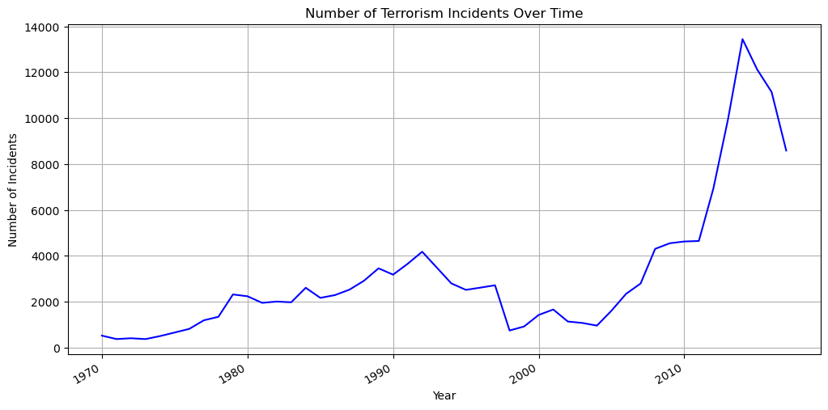
Year: Analyze trends over time to understand how terrorism has evolved
The graph indicates that there has been fluctuation in the number of terrorism incidents over the years. There appears to be a general increasing trend from the earlier years to a peak around 2014, followed by a gradual decrease in the number of incidents in recent years.

Slide 6
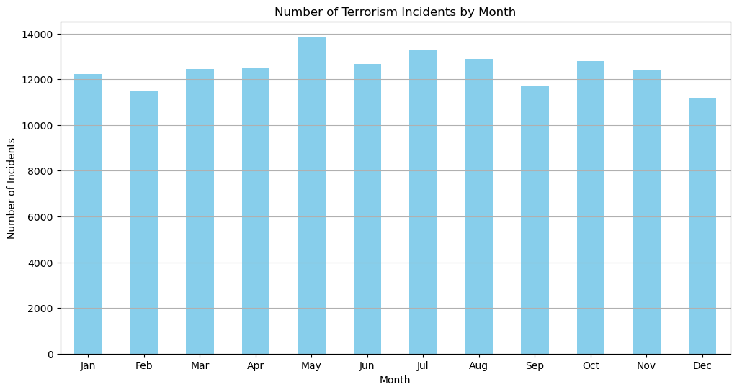
Month: Examine seasonal patterns in terrorist activities.
From the graph, the number of terrorism incidents by month, shows a variation across different months with the months of May, June, July, and August have higher numbers of incidents compared to other months, suggesting a possible seasonal pattern. However, further analysis would be needed to confirm this pattern and understand its underlying causes.

Slide 7
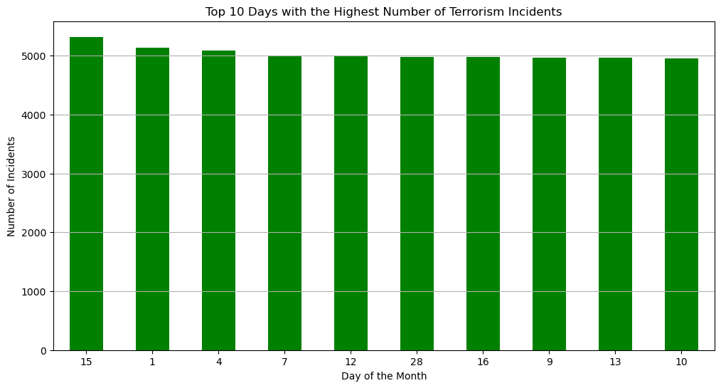
Look for specific days with highest incidents.
The bar chart shows the top 10 days with the highest number of terrorism incidents. Each bar represents a day of the month, and the height of the bar indicates the number of incidents that occurred on that day. The chart suggest higher incidents at the middle and beginning of the month.

Slide 8
(B) Geographical Attributes
country_txt (Country): Identify countries with the highest number of incidents
region_txt (Region): Understand regional patterns and hotspots
provstate (Province/State): Drill down to more specific locations within countries
Top 5 countries with the highest incidents.
latitude and longitude: Map the incidents for spatial analysis

Slide 9
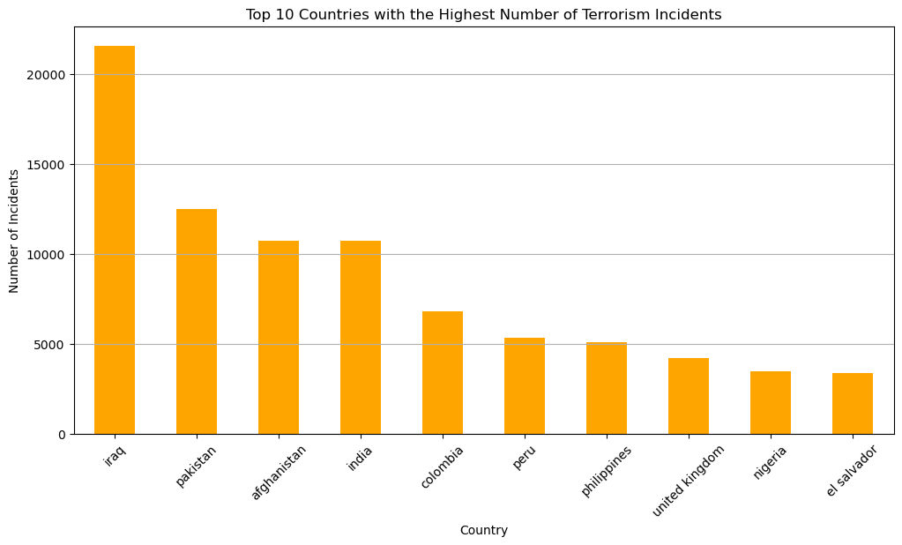
country_txt (Country): Identify countries with the highest number of incidents
The graph shows top 10 countries with highest number of Terrorism incidents. Leading is Iraq with over 20,000 incidents and El Salvador at position 10 with about 3,000 incidents..

Slide 10
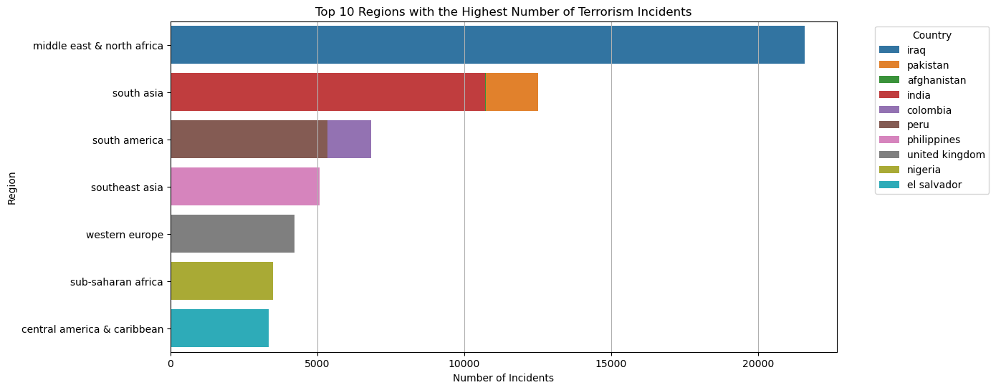
region_txt (Region): Understand regional patterns and hotspots
The Middle-East and North Africa is the region with the highest number of Terrorism incidents and particularly in Iraq.

Slide 11
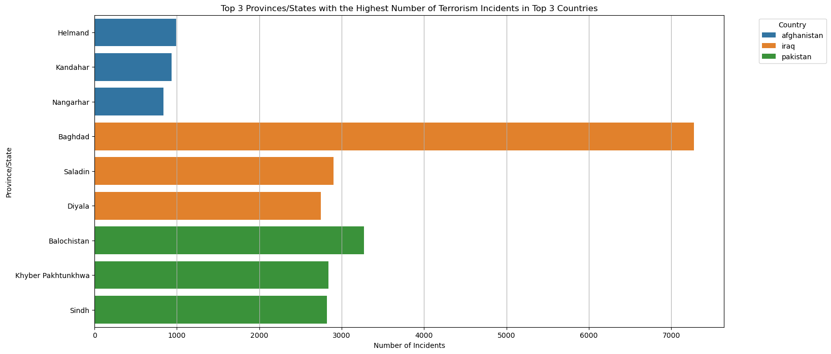
provstate (Province/State): Drill down to more specific locations within countries
The top three states with the highest number of terrorism incidents are Iraq (particularly in Baghdad), Pakistan and Afghanistan.

Slide 12
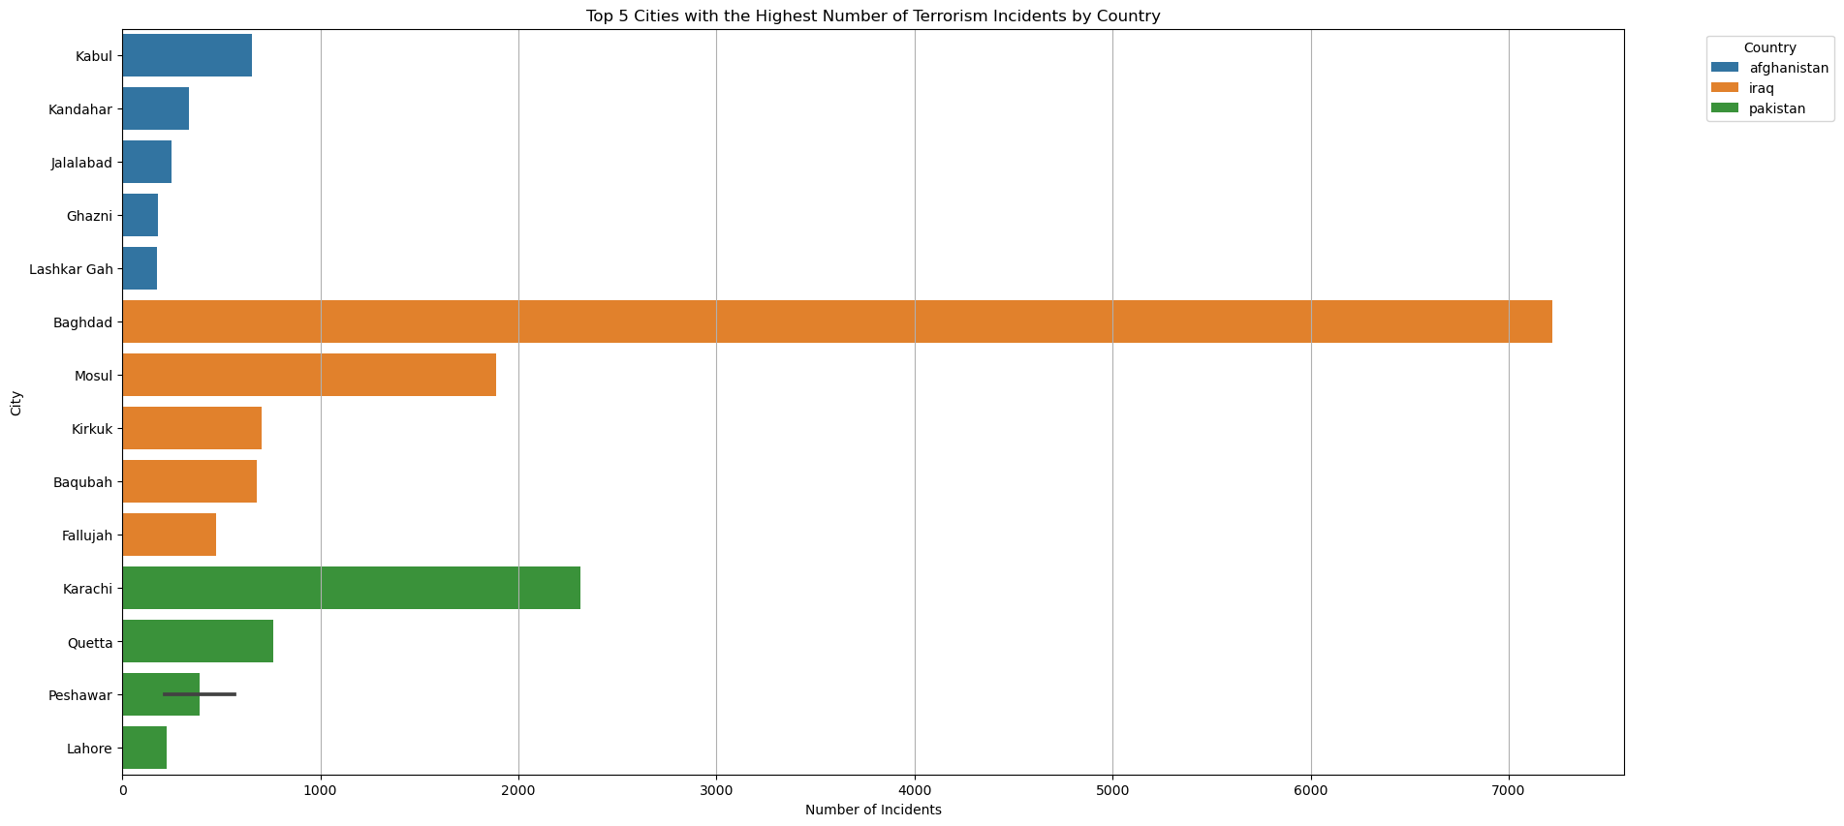
Top 5 Cities in 3 countries with the highest incidents
The leading cities with the highest number of terrorism attacks are: Baghdad and Mosul in Iraq, Karachi and Quetta in Pakistan and Kabul in Iraq.

Slide 13
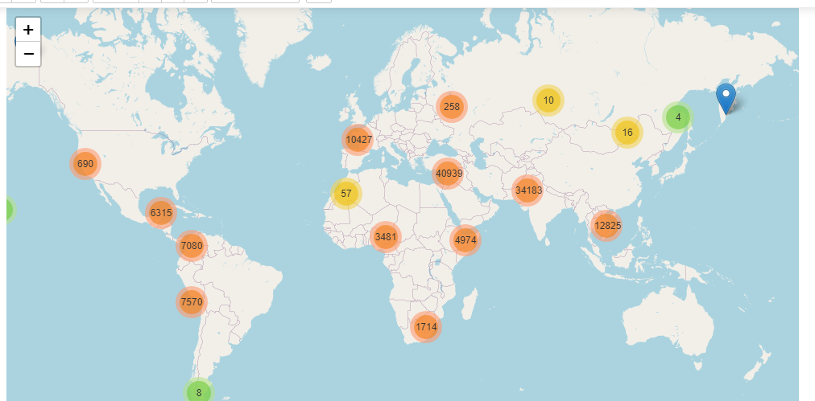
latitude and longitude: Map the incidents for spatial analysis
The map shows the global distribution of terrorism incidents between years 1970 and 2017 with more incidents in the Middle East, India and Pakistan.

Slide 14
(C) Incidents Characteristics
attacktype1_txt (Primary Attack Type): Determine the most common types of attack
attacktype2_txt (Secondary Attack Type): Analyze the combination of attack types
success: Evaluate the success rate of attacks
suicide: Understand the prevalence of suicide attacks (1=Yes, 0=No)
extended: Investigate incidents lasting more than 24 hours (1=Yes, 0=No)

Slide 15
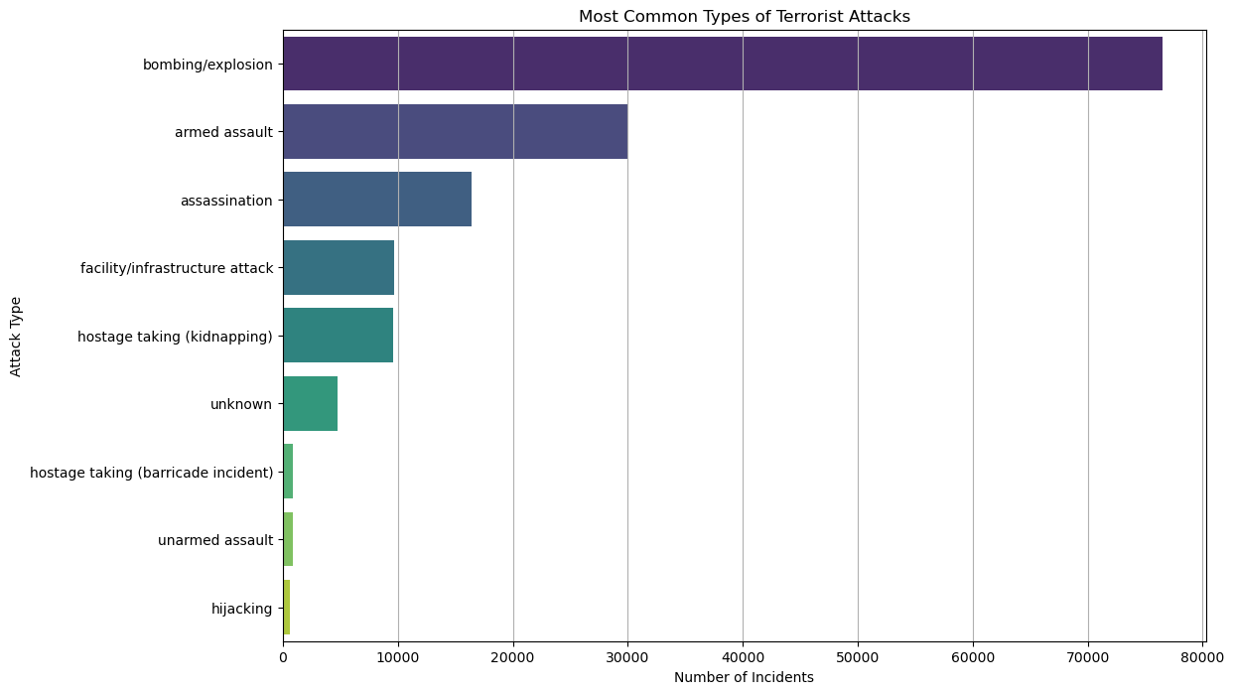
attacktype1_txt (Primary Attack Type): Determine the most common types of attack
The visual representation of the 3 most common types of attacks are: Bombing/Explosion; Armed Assault and Assassination respectively.

Slide 16
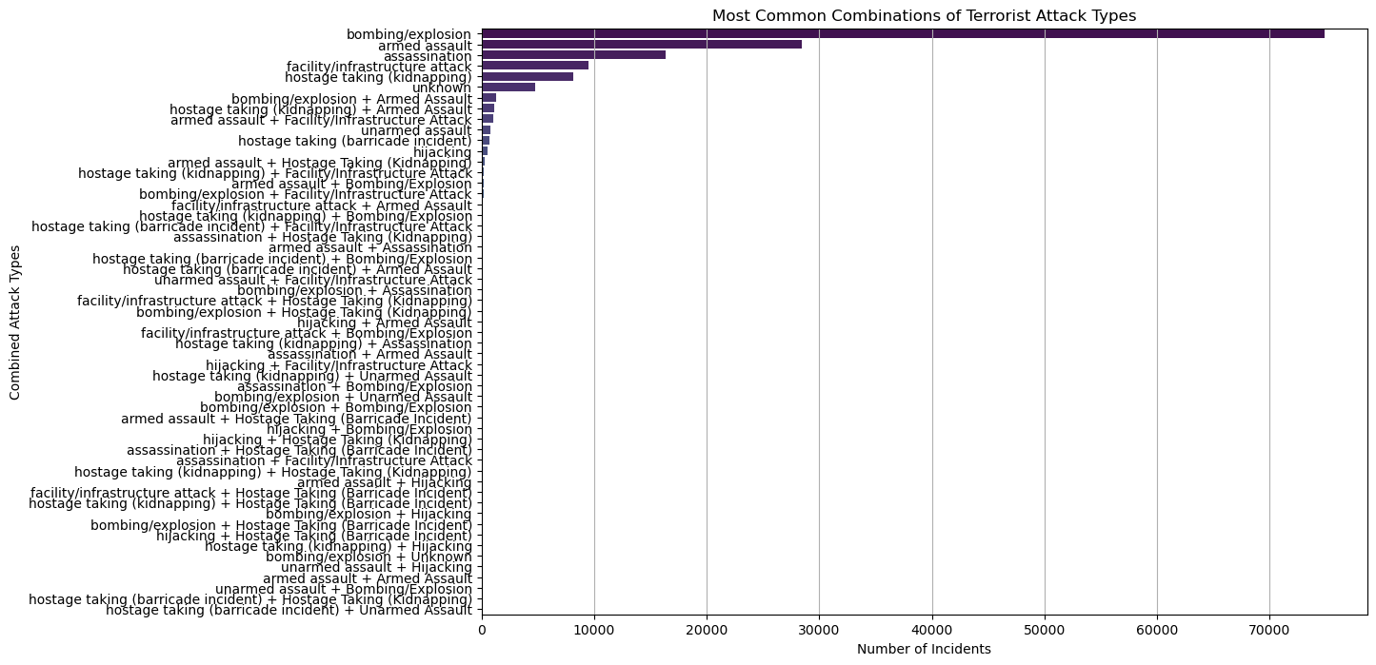
attacktype2_txt (Secondary Attack Type): Analyze the combination of attack types
The graph shows that the most common 4 combinations of terrorism attack are: bombing/explosion, armed assault, facility/infrustracture attack and hostage taking (kidnapping).

Slide 17
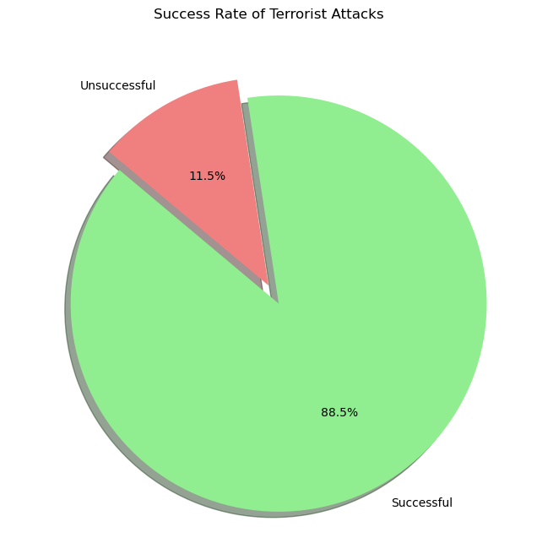
success: Evaluate the success rate of attacks
The above graphs shows a visual representation of the proportion of successful vs. unsuccessful attacks. With successful rate standing at 88.5%.

Slide 18
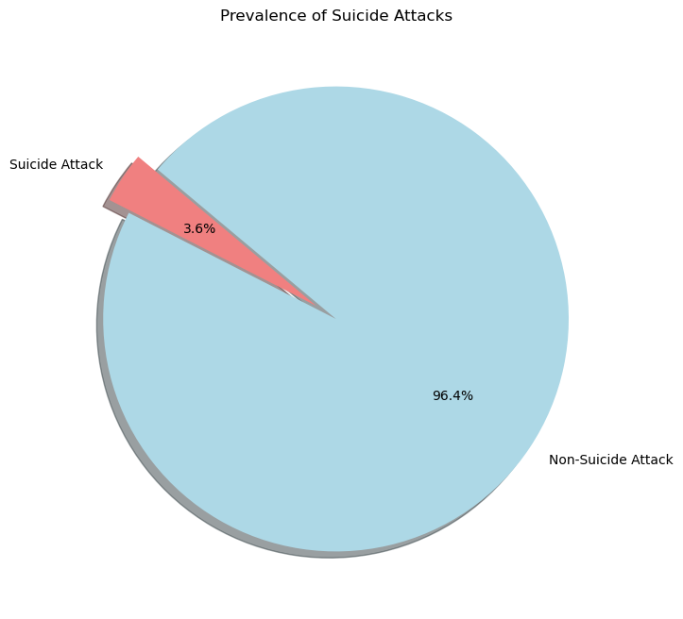
suicide: Understand the prevalence of suicide attacks (1=Yes, 0=No)
The above graph shows a visual representation of the proportion of suicide vs. non-suicide attacks with Non-suicide attacks being the highest at 96.4%.

Slide 19
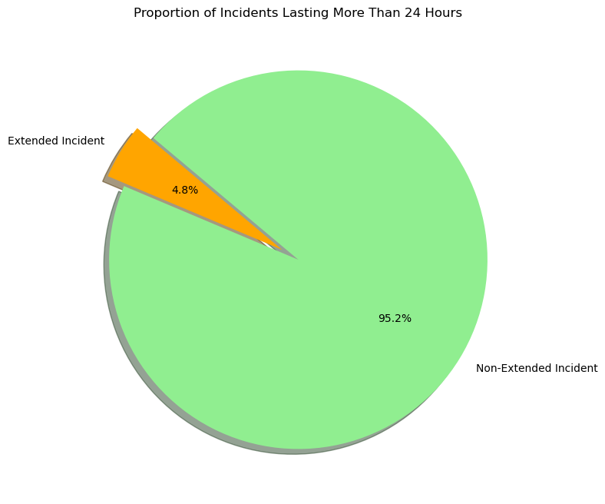
extended: Investigate incidents lasting more than 24 hours (1=Yes, 0=No)
The above code provides us with the proportion of incidents lasting more than 24 hours and a visual representation of the proportion of extended vs. non-extended incidents. The Non-extended incidents are at 95.2%.

Slide 20
(D) Target and Victim Information
targtype1_txt (Primary Target Type): Identify common target of attacks.
corp1 (Target Entity): Details of specific target entities.
nkill (Number of Fatalities): Analyse the human cost of terrorism.
nwound (Number of injuries): Assess the impact of victims.
nhostkid (Number of Hostages/Kidnapping Victims): Examine incidents involving hostages.

Slide 21
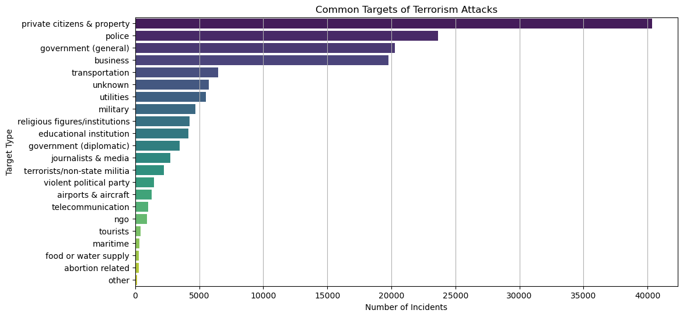
targtype1_txt (Primary Target Type): Identify common target of attacks.
The 5 leading incidents and their numbers are:
Private citizens & property (40345); Police (23650); Government (general) (20257); Business (19760); and Transportation (6484).

Slide 22
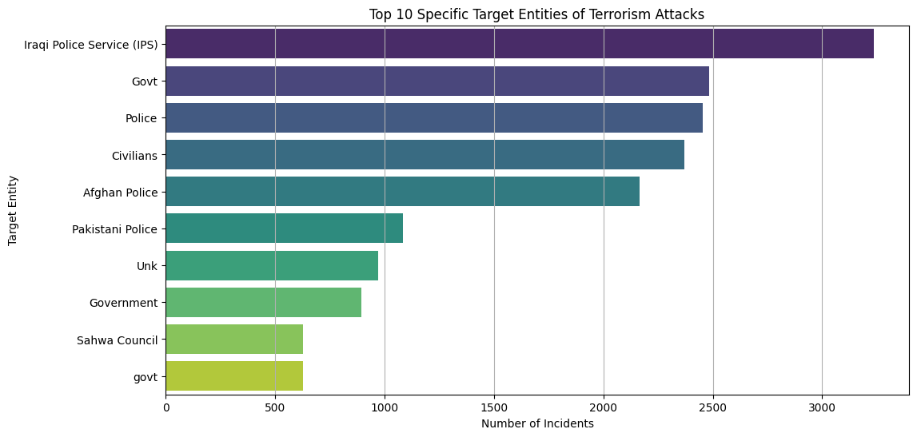
corp1 (Target Entity): Details of specific target entities.
From the graph we see that the leading target entities are: Police in general followed by Civilians.

Slide 23
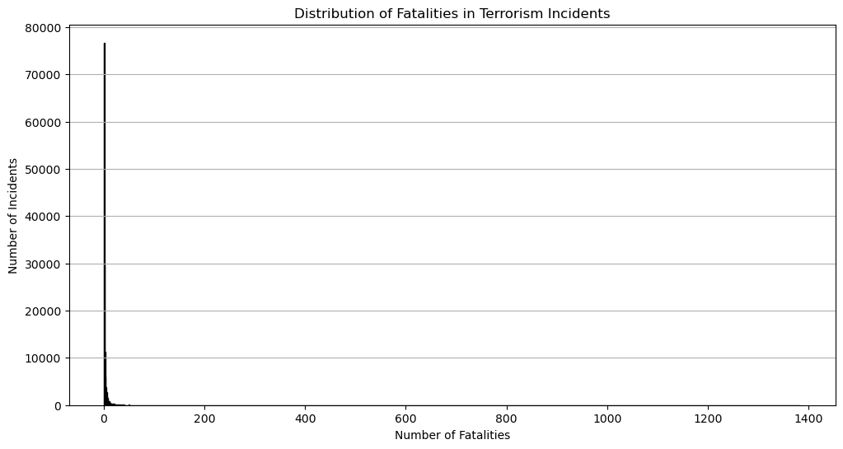
nkill (Number of Fatalities): Analyse the human cost of terrorism.
From the graph we see that the number of fatalities in most incidents were between 1 and 50.

Slide 24
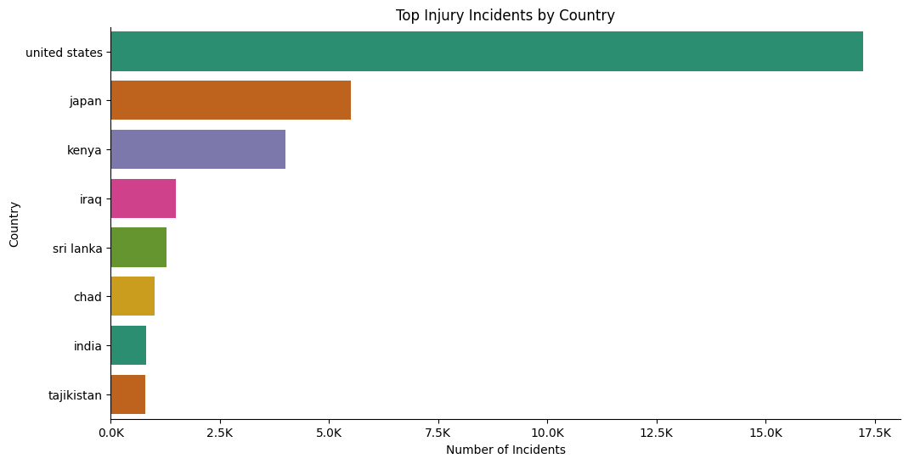
nwound (Number of injuries): Assess the impact of victims.
The graph shows the distribution of injuries in terrorism attacks in 8 most affected countries. With United States of America, Japan, Kenya, Iraq and Sri Lanka leading respectively.

Slide 25
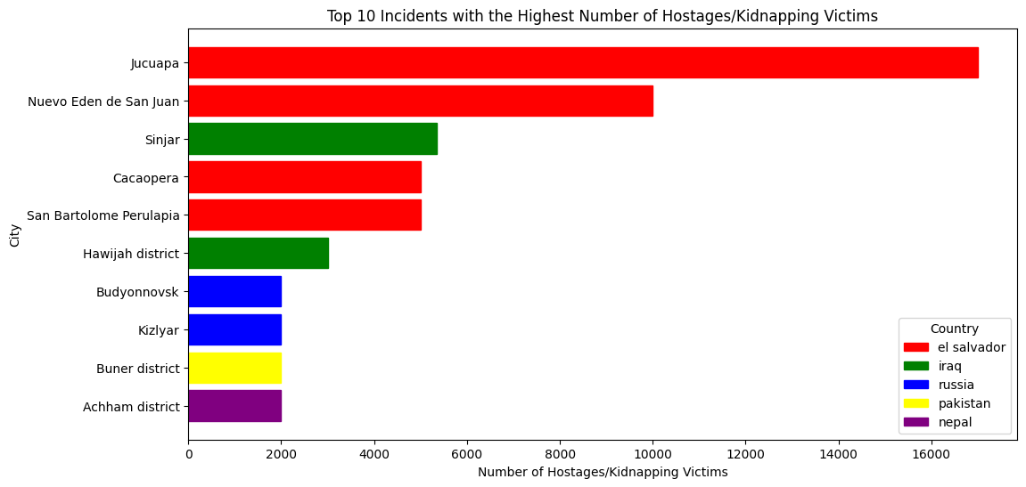
nhostkid (Number of Hostages/Kidnapping Victims): Examine incidents involving hostages.
Most hostages/kidnapping took place in El Salvador, Iraq, Russia, Pakistan and Nepal.

Slide 26
(E) Perpetrator Information
gname (Perpetrator Group): Identify groups responsible for the most incidents.
individual: Look into incidents carried out by individuals. (1=Yes, 0=No)
nperps (Number of Perpertrators): Analyze group size involved in incidents.

Slide 27
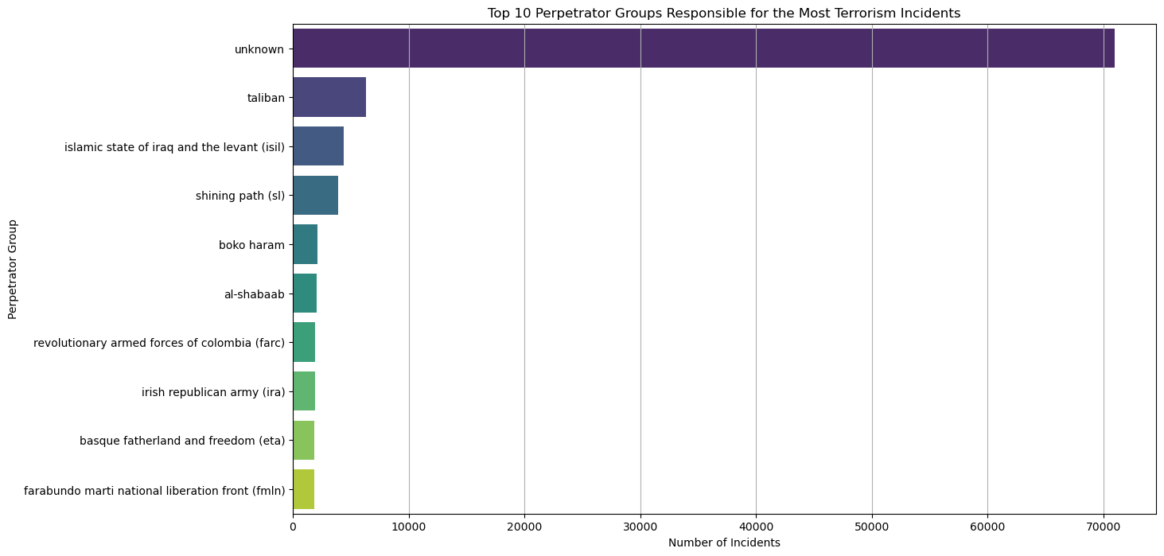
gname (Perpetrator Group): Identify groups responsible for the most incidents.
Most incidents were carried out by unknown perpetrators followed by the Taliban, ISIL, Shining Path, Boko Haram and Al-Shabaab respectively.

Slide 28
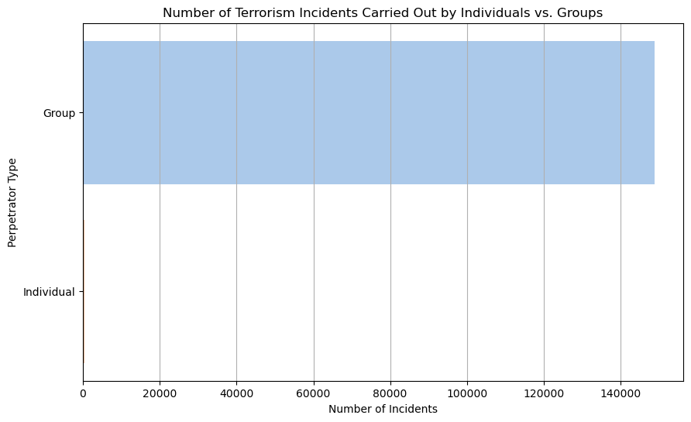
individual: Look into incidents carried out by individuals. (1=Yes, 0=No)
The graphs shows that most terrorism incidents are carried out by Groups.

Slide 29
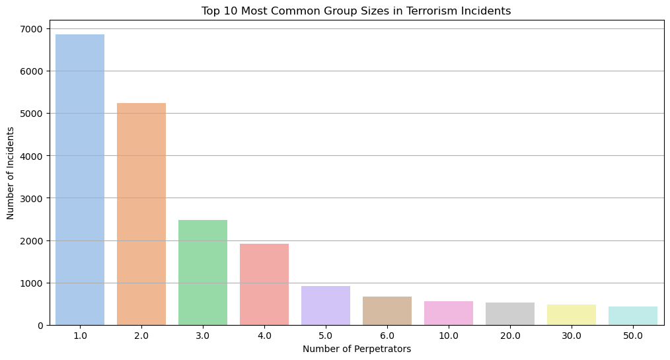
nperps (Number of Perpertrators): Analyze group size involved in incidents.
The graph shows that incidents perpetrated by one person stood at 6867 although those carried by groups summed to over 140,000.

Slide 30
(F) Weapon Information
weaptype1_txt (primary Weapon Type): Determine the most commonly used weapons.
weapsubtype1_txt (Primary Weapon Subtype): Further detail on weaponry.

Slide 31
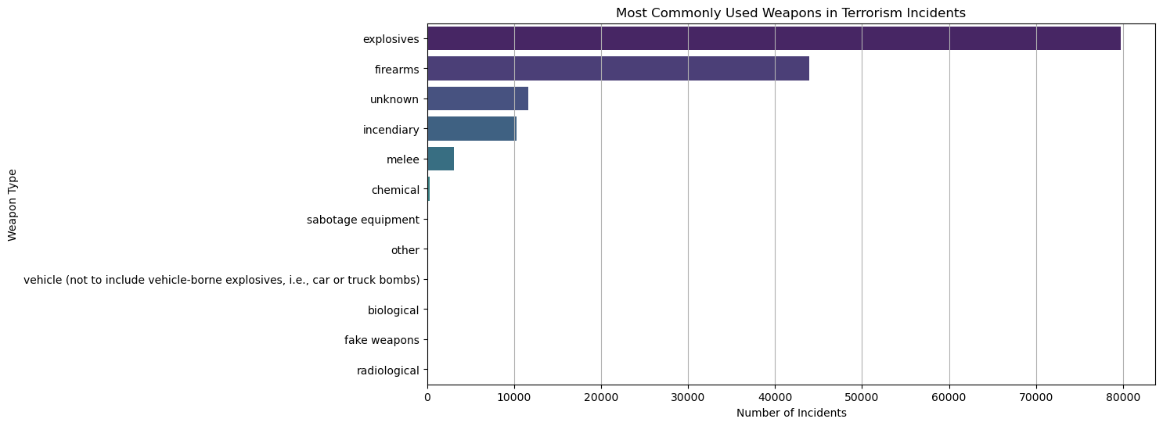
weaptype1_txt (primary Weapon Type): Determine the most commonly used weapons.
From the graph we see that Explosive and Firearms are the two mostly used weapons in Terrorism incidents.

Slide 32
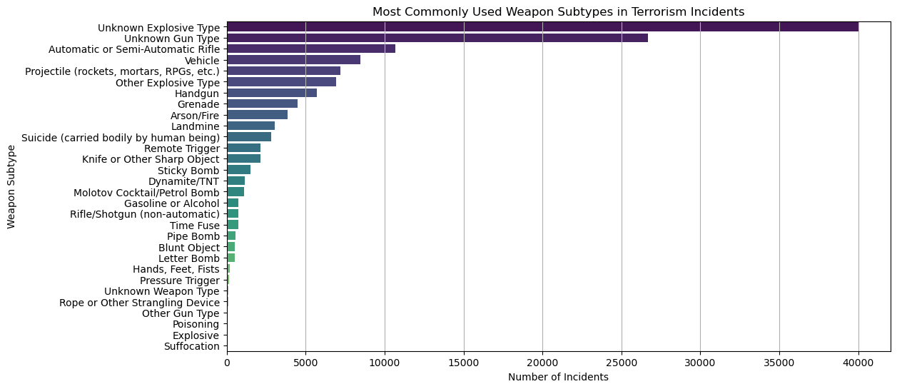
weapsubtype1_txt (Primary Weapon Subtype): Further detail on weaponry.
The 5 most commonly used weapon sub-types are: Unknown Explosives; Unknown Gun Types; Automatic or Semi-Automatic Rifle; Vehicles; and Projectile (rockets, mortars, RPGs, etc.).

Slide 33
(G) Property and Economic Impact
property: Incidents involving property damage.
propvalue (Value of Property Damaged): Financial cost of incidents.

Slide 34
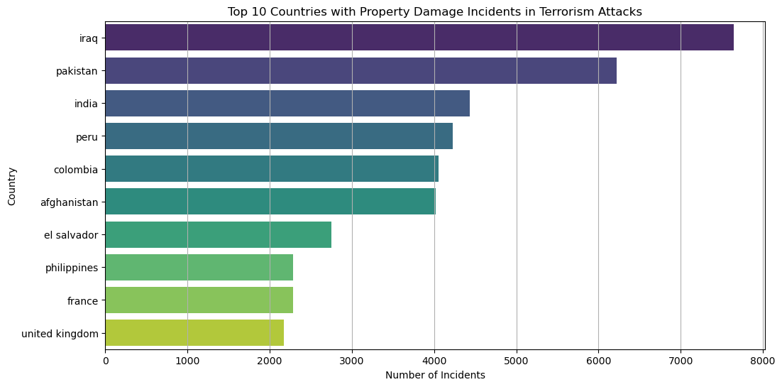
property: Incidents involving property damage.
Highest property damage was reported in Iraq, Pakistan, India, Peru and Colombia respectively.

Slide 35
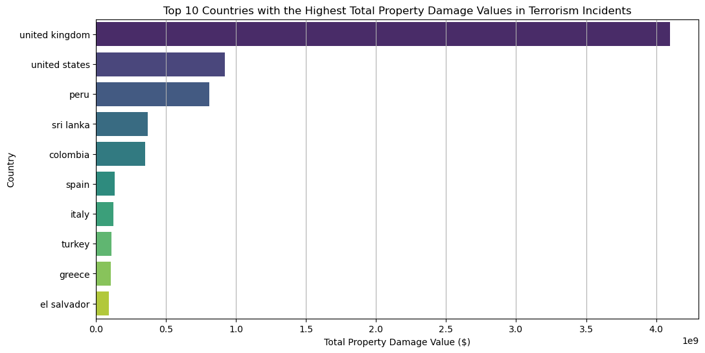
propvalue (Value of Property Damaged): Financial cost of incidents.
The 3 countries that suffered highest property damage in value($) were: United Kingdom (over 4B dollars), United States of America (almost 1B dollars) and Peru (about 0.8B dollars).

Slide 36
(H) Additional Context
motive: Explore the motives behind the attacks.
claimed: Understand if incidents were claimed by groups.
ransom: Investigate incidents involving ransom demands.

Slide 37
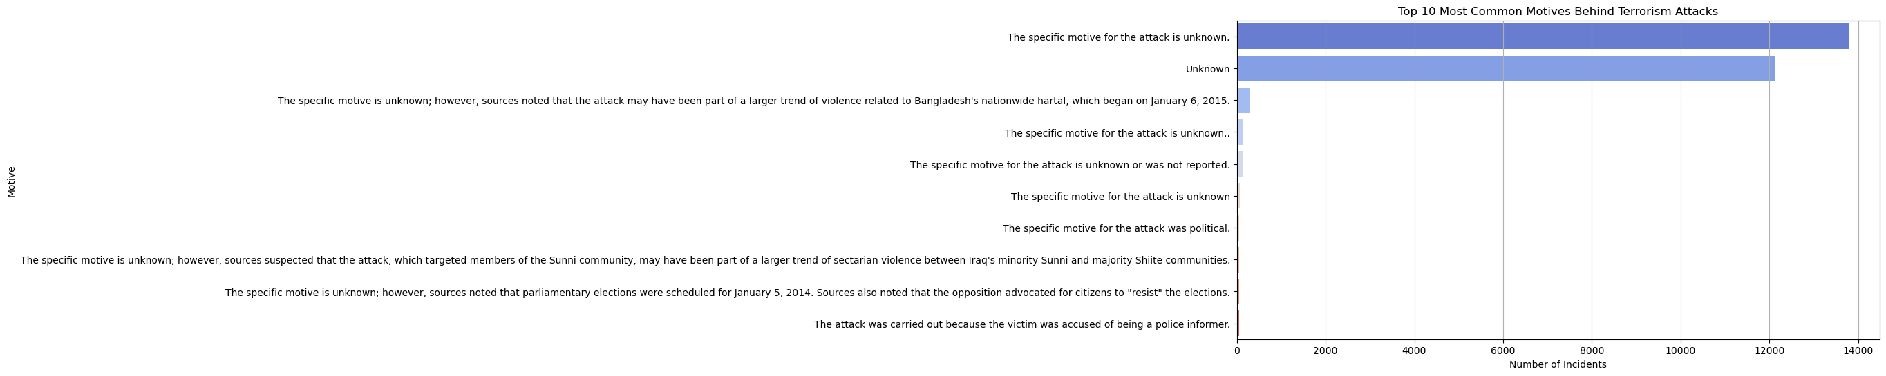
motive: Explore the motives behind the attacks.

Slide 38
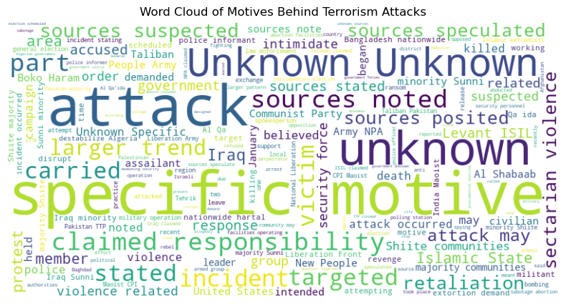
motive: Explore the motives behind the attacks.
From the word cloud, it is evident that the most pronounced motives behind terrorism attacks were those with specific motives, followed by sporadic attacks and the unknown reasons.

Slide 39
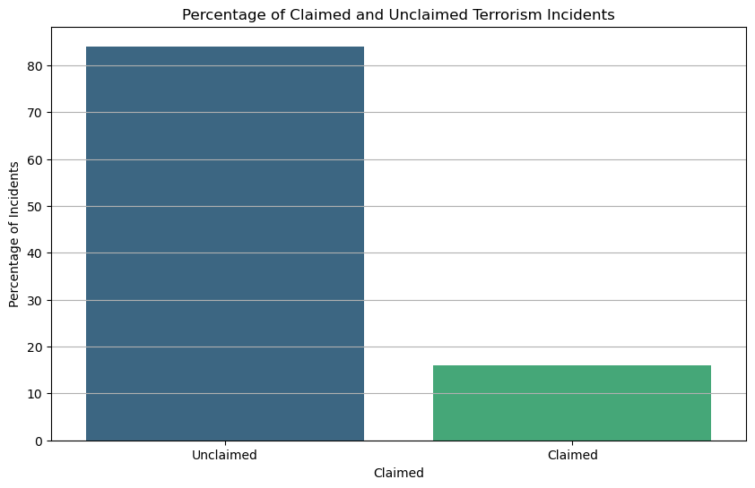
ransom: Investigate incidents involving ransom demands.
The unclaimed incidents were about 85% with the claimed ones being 15%.

Slide 40
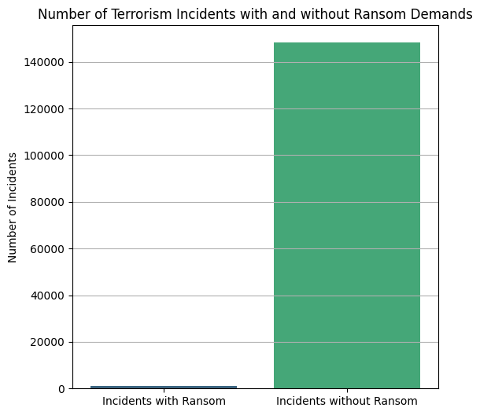
ransom: Investigate incidents involving ransom demands.
The graph shows that most incidents were without demand for ransom.

Slide 41
Key findings:
Temporal Trends: Terrorism incidents fluctuated over the years, peaking around 2014.
Geographical Hotspots: Iraq, Pakistan, and Afghanistan are among the countries with the highest incidents, with Baghdad, Karachi, and Kabul as the top cities.
Incident Characteristics: Bombings, armed assaults, and assassinations are the most common attack types, with a high success rate of 88.5%.
Target and Victim Information: Civilians and police are the primary targets, with significant fatalities and injuries reported.
Perpetrator Groups: Unknown groups, the Taliban, ISIL, Shining Path, Boko Haram, and Al-Shabaab are the most active.
Weapon Usage: Explosives and firearms are predominantly used in attacks.
Economic Impact: Iraq, Pakistan, and India reported the highest property damages, with the UK, USA, and Peru facing the highest financial losses.
Additional Context: The motives behind attacks vary, with many incidents remaining unclaimed or without ransom demands.

